Slide 1
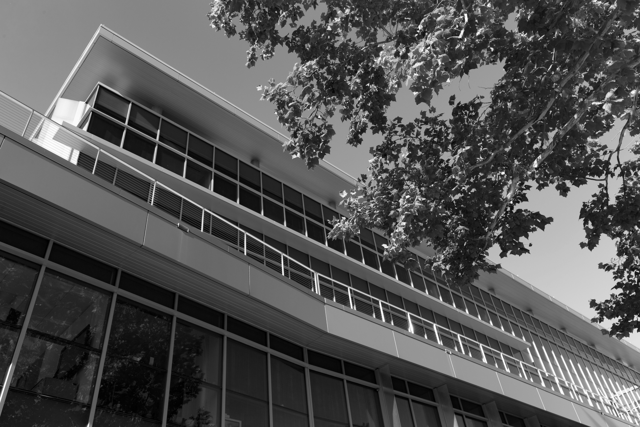

CLINICAL RESEARCH CENTER
presents
Scheduling Participant Visits
With WebCAMP CUIC forms
The UF CTSI is supported in part by NIH Clinical and Translational Science Awards UL1TR001427, KL2TR001429 and TL1TR001428.
This content is solely the responsibility of the UF CTSI and does not necessarily represent the official views of the NIH.

Slide 2

This module is designed to instruct research study investigators, coordinators and other staff how to request a scheduled admission of a study participant to the CRC using the WebCAMP Research Management System.
INTRODUCTION
The UF CTSI is supported in part by NIH Clinical and Translational Science Awards UL1TR001427, KL2TR001429 and TL1TR001428.
This content is solely the responsibility of the UF CTSI and does not necessarily represent the official views of the NIH.

Slide 3
What is WebCAMP?
WebCAMP, or Web-based Center Administrative Management Program is an integrated toolset designed to administer and track the activities of clinical research organizations such as the CTSI.
The UF CTSI is supported in part by NIH Clinical and Translational Science Awards UL1TR001427, KL2TR001429 and TL1TR001428.
This content is solely the responsibility of the UF CTSI and does not necessarily represent the official views of the NIH.

Slide 4
Why should I use WebCAMP?
Using WebCAMP to request, create and administer study participant visits will allow smoother, more accurate and more efficient delivery of study related services. This will result in greater service satisfaction for study staff and research participants, as well as improved efficiency for CRC personnel.
The UF CTSI is supported in part by NIH Clinical and Translational Science Awards UL1TR001427, KL2TR001429 and TL1TR001428.
This content is solely the responsibility of the UF CTSI and does not necessarily represent the official views of the NIH.

Slide 5
What happens when a protocol is registered?
When a protocol is registered with the Clinical Research Center (CRC), WebCAMP login credentials and a link to the schedule request CUICform will be emailed to all listed study personnel.
The UF CTSI is supported in part by NIH Clinical and Translational Science Awards UL1TR001427, KL2TR001429 and TL1TR001428.
This content is solely the responsibility of the UF CTSI and does not necessarily represent the official views of the NIH.

Slide 6
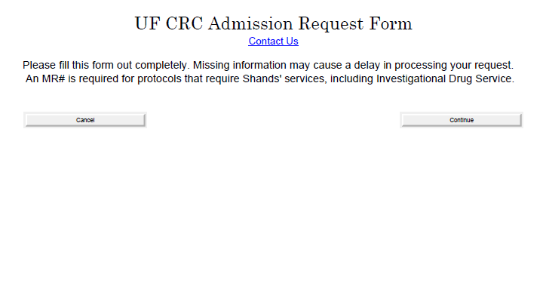
SCHEDULE REQUEST
Clicking the link to the CUICform opens the CRC schedule request form.
The UF CTSI is supported in part by NIH Clinical and Translational Science Awards UL1TR001427, KL2TR001429 and TL1TR001428.
This content is solely the responsibility of the UF CTSI and does not necessarily represent the official views of the NIH.

Slide 7
SCHEDULE REQUEST
Please note the instructions on the form above. All required information must be filled out or the request may be delayed or rejected.
The UF CTSI is supported in part by NIH Clinical and Translational Science Awards UL1TR001427, KL2TR001429 and TL1TR001428.
This content is solely the responsibility of the UF CTSI and does not necessarily represent the official views of the NIH.

Slide 8
SCHEDULE REQUEST
Click on the button labeled “Continue” to proceed to the form data entry.
The UF CTSI is supported in part by NIH Clinical and Translational Science Awards UL1TR001427, KL2TR001429 and TL1TR001428.
This content is solely the responsibility of the UF CTSI and does not necessarily represent the official views of the NIH.

Slide 9
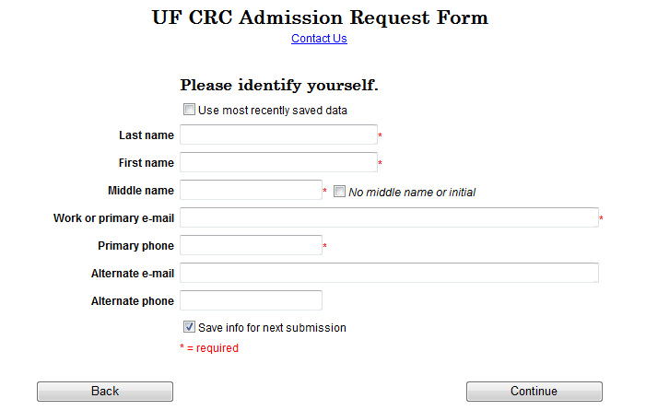

SCHEDULE REQUEST
Good
Johnny
B
myemail@abc.edu
999-999-9999
Enter your name, email, and phone number in the boxes shown. Entries marked with * are required fields. You will be unable to continue to the next screen if any required fields are left blank.
The UF CTSI is supported in part by NIH Clinical and Translational Science Awards UL1TR001427, KL2TR001429 and TL1TR001428.
This content is solely the responsibility of the UF CTSI and does not necessarily represent the official views of the NIH.

Slide 10
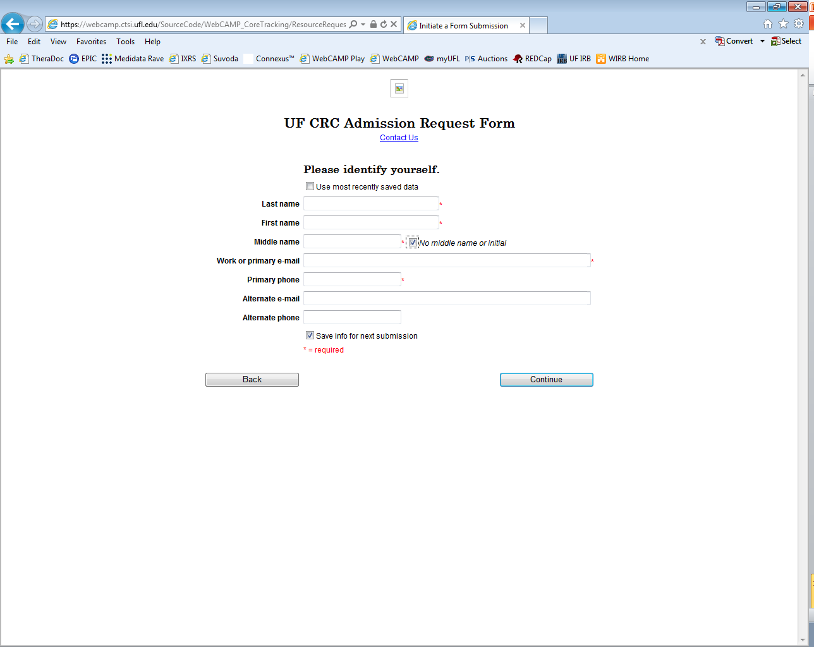
SCHEDULE REQUEST
Good
Johnny
myemail@abc.edu
999-999-9999
If you are not entering a middle name or initial, then the “No middle name or initial” box must be checked.
The UF CTSI is supported in part by NIH Clinical and Translational Science Awards UL1TR001427, KL2TR001429 and TL1TR001428.
This content is solely the responsibility of the UF CTSI and does not necessarily represent the official views of the NIH.

Slide 11
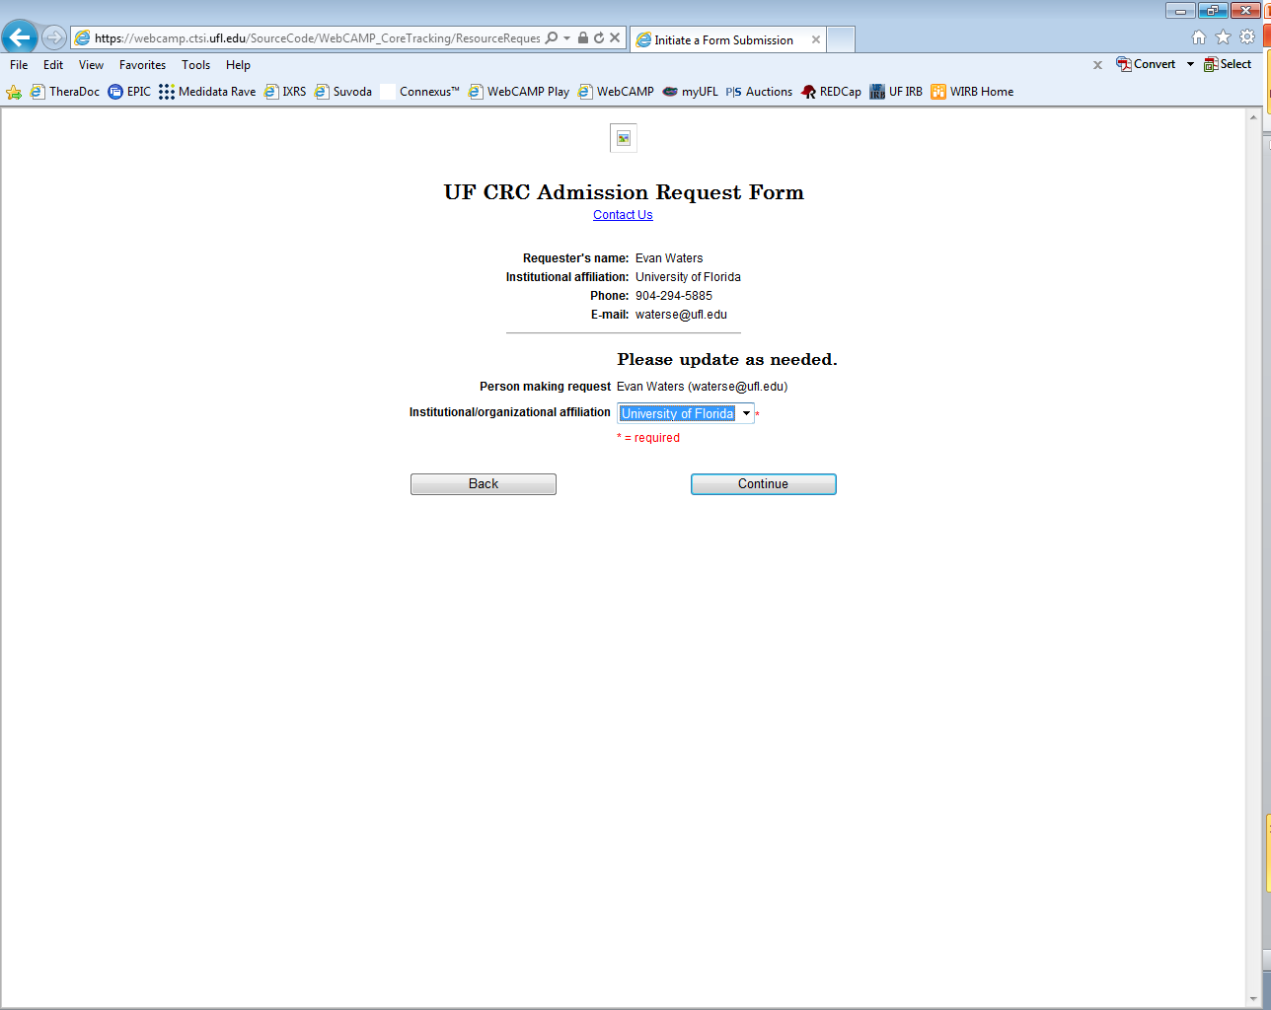
SCHEDULE REQUEST
The information you entered will appear on the next page of the form. Please be sure that it is accurate before you continue. If at anytime you need to correct information, please use the form’s “Back” button rather than your browser back button.
The UF CTSI is supported in part by NIH Clinical and Translational Science Awards UL1TR001427, KL2TR001429 and TL1TR001428.
This content is solely the responsibility of the UF CTSI and does not necessarily represent the official views of the NIH.

Slide 12
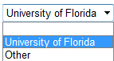
SCHEDULE REQUEST
Select your organizational affiliation by clicking on the drop box arrow. Click on the correct organization from the drop down list, or click “other” if your organization is not listed.
The UF CTSI is supported in part by NIH Clinical and Translational Science Awards UL1TR001427, KL2TR001429 and TL1TR001428.
This content is solely the responsibility of the UF CTSI and does not necessarily represent the official views of the NIH.

Slide 13
SCHEDULE REQUEST
My Organization
Selecting “other” will bring up an additional text box in which your organization may be entered. This is a required field. Clicking the “Continue” button will bring you to the next page of the form.
The UF CTSI is supported in part by NIH Clinical and Translational Science Awards UL1TR001427, KL2TR001429 and TL1TR001428.
This content is solely the responsibility of the UF CTSI and does not necessarily represent the official views of the NIH.

Slide 14
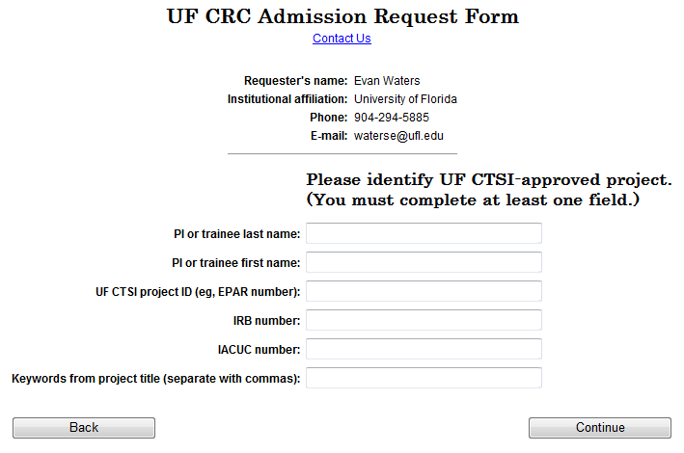
SCHEDULE REQUEST
Next you will enter data to identify the study you wish to schedule a subject for. You may enter the PI name, CTSI project number, IRB number, IACUC number or a keyword from the project title.
The UF CTSI is supported in part by NIH Clinical and Translational Science Awards UL1TR001427, KL2TR001429 and TL1TR001428.
This content is solely the responsibility of the UF CTSI and does not necessarily represent the official views of the NIH.

Slide 15
SCHEDULE REQUEST
Stethoscope
Sally
You may enter data in one field or several. Entering data in multiple fields such as PI first and last name may narrow down the number of selections available.
The UF CTSI is supported in part by NIH Clinical and Translational Science Awards UL1TR001427, KL2TR001429 and TL1TR001428.
This content is solely the responsibility of the UF CTSI and does not necessarily represent the official views of the NIH.

Slide 16
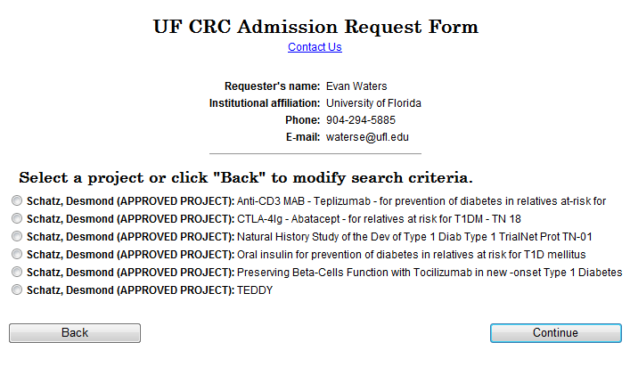
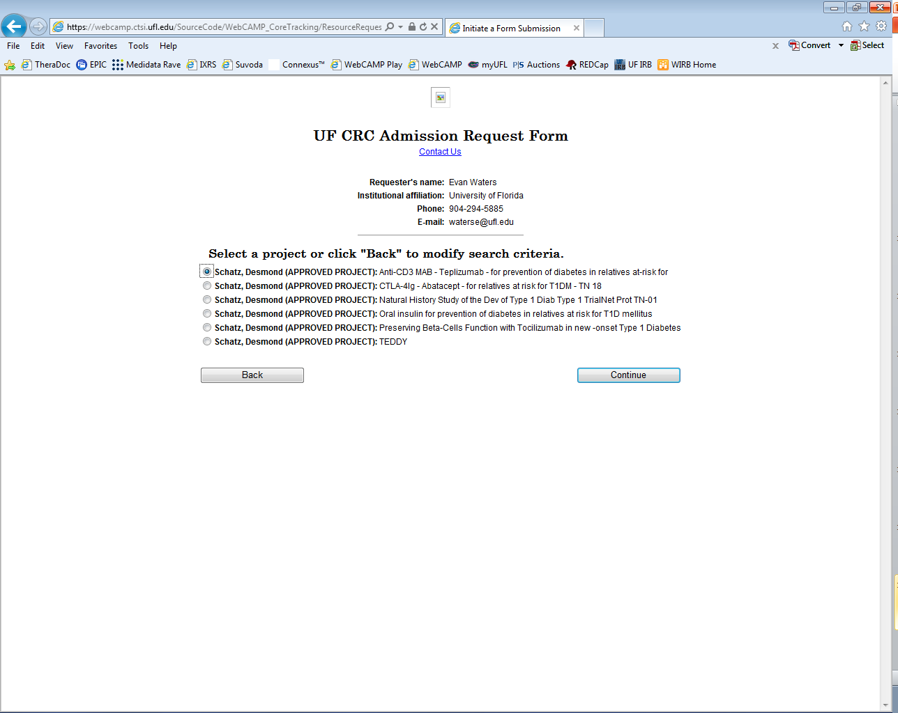
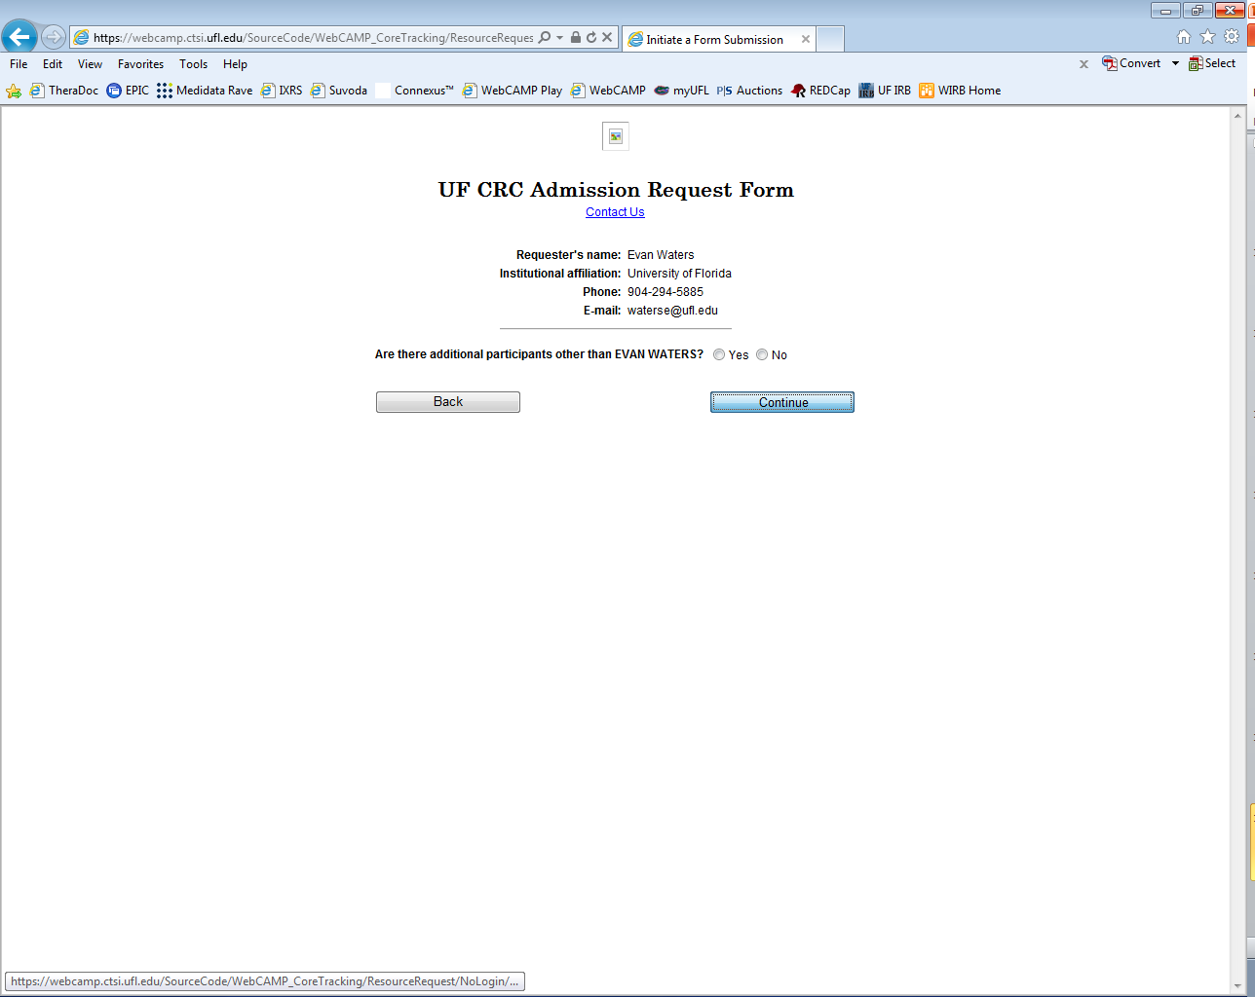
SCHEDULE REQUEST
Searching by name or keyword may result in multiple results. Click on the project you are scheduling the subject for. Click continue to accept the selection and progress to the next screen.
The UF CTSI is supported in part by NIH Clinical and Translational Science Awards UL1TR001427, KL2TR001429 and TL1TR001428.
This content is solely the responsibility of the UF CTSI and does not necessarily represent the official views of the NIH.

Slide 17
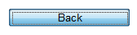
SCHEDULE REQUEST
If there are too many search results, click “Back” to return to the previous screen and modify the search criteria.
The UF CTSI is supported in part by NIH Clinical and Translational Science Awards UL1TR001427, KL2TR001429 and TL1TR001428.
This content is solely the responsibility of the UF CTSI and does not necessarily represent the official views of the NIH.

Slide 18
SCHEDULE REQUEST
Please note: You must select an approved protocol. You will not be able to schedule an appointment for a protocol that has not been approved or has expired.
The UF CTSI is supported in part by NIH Clinical and Translational Science Awards UL1TR001427, KL2TR001429 and TL1TR001428.
This content is solely the responsibility of the UF CTSI and does not necessarily represent the official views of the NIH.

Slide 19
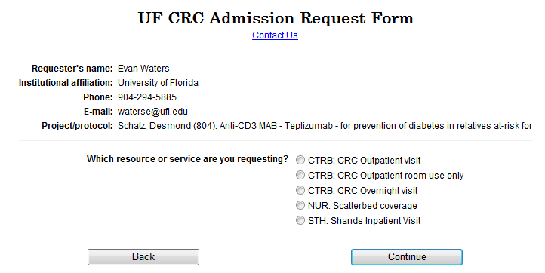
SCHEDULE REQUEST
Select the resource or service type that applies to the visit you wish to schedule.
The UF CTSI is supported in part by NIH Clinical and Translational Science Awards UL1TR001427, KL2TR001429 and TL1TR001428.
This content is solely the responsibility of the UF CTSI and does not necessarily represent the official views of the NIH.

Slide 20
SCHEDULE REQUEST
Select CTRB: CRC Outpatient visit to schedule a room in the CRC including supplies, equipment and staffing resources.
The UF CTSI is supported in part by NIH Clinical and Translational Science Awards UL1TR001427, KL2TR001429 and TL1TR001428.
This content is solely the responsibility of the UF CTSI and does not necessarily represent the official views of the NIH.

Slide 21
SCHEDULE REQUEST
Select CTRB: CRC Outpatient room use only to schedule a room in the CRC without supplies, equipment or staffing resources.
The UF CTSI is supported in part by NIH Clinical and Translational Science Awards UL1TR001427, KL2TR001429 and TL1TR001428.
This content is solely the responsibility of the UF CTSI and does not necessarily represent the official views of the NIH.

Slide 22
SCHEDULE REQUEST
Select CTRB: CRC Overnight visit to schedule a room in the CRC for an overnight stay.
The UF CTSI is supported in part by NIH Clinical and Translational Science Awards UL1TR001427, KL2TR001429 and TL1TR001428.
This content is solely the responsibility of the UF CTSI and does not necessarily represent the official views of the NIH.

Slide 23
SCHEDULE REQUEST
Select NUR: Scatterbed coverage to request nursing services to be performed in a location other than the CRC.
The UF CTSI is supported in part by NIH Clinical and Translational Science Awards UL1TR001427, KL2TR001429 and TL1TR001428.
This content is solely the responsibility of the UF CTSI and does not necessarily represent the official views of the NIH.

Slide 24
SCHEDULE REQUEST
Select STH: Shands Inpatient Visit To request CRC services for participants that have been admitted to Shands Hospital for study related procedures.
The UF CTSI is supported in part by NIH Clinical and Translational Science Awards UL1TR001427, KL2TR001429 and TL1TR001428.
This content is solely the responsibility of the UF CTSI and does not necessarily represent the official views of the NIH.

Slide 25
SCHEDULE REQUEST
Click “Continue” to accept the current selection and proceed to the next screen.
The UF CTSI is supported in part by NIH Clinical and Translational Science Awards UL1TR001427, KL2TR001429 and TL1TR001428.
This content is solely the responsibility of the UF CTSI and does not necessarily represent the official views of the NIH.

Slide 26
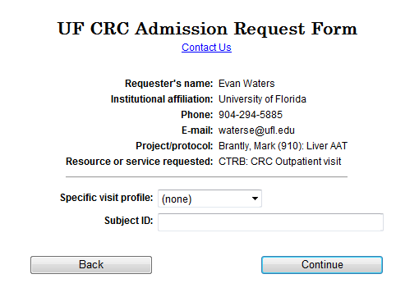
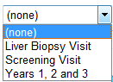
SCHEDULE REQUEST
On this screen the specific visit profile will be selected. Visit profiles are created when a study is registered with the CRC and are preloaded into the system. Click the down arrow next to the visit profile dropdown box.
The UF CTSI is supported in part by NIH Clinical and Translational Science Awards UL1TR001427, KL2TR001429 and TL1TR001428.
This content is solely the responsibility of the UF CTSI and does not necessarily represent the official views of the NIH.

Slide 27
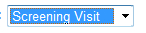
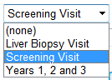
SCHEDULE REQUEST
Select the visit type you are scheduling from the visit profile list. If you do not see the visit profile you need, please contact the CRC by clicking the contact link.
The UF CTSI is supported in part by NIH Clinical and Translational Science Awards UL1TR001427, KL2TR001429 and TL1TR001428.
This content is solely the responsibility of the UF CTSI and does not necessarily represent the official views of the NIH.

Slide 28
SCHEDULE REQUEST
Study123
Enter the study specific Subject ID for the participant you wish to schedule. Click “Continue” to accept selections and progress to the next screen.
The UF CTSI is supported in part by NIH Clinical and Translational Science Awards UL1TR001427, KL2TR001429 and TL1TR001428.
This content is solely the responsibility of the UF CTSI and does not necessarily represent the official views of the NIH.

Slide 29
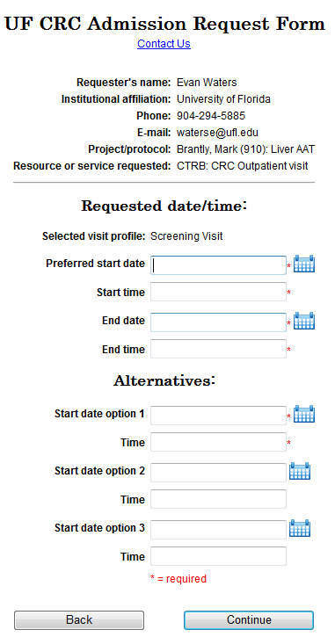
SCHEDULE REQUEST
On this screen you will enter the date and time you wish to schedule the participant in the CRC. Enter your Preferred appointment date and time in the top section.
The UF CTSI is supported in part by NIH Clinical and Translational Science Awards UL1TR001427, KL2TR001429 and TL1TR001428.
This content is solely the responsibility of the UF CTSI and does not necessarily represent the official views of the NIH.

Slide 30
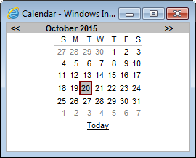
SCHEDULE REQUEST
You may enter the date directly into the data entry field, or you may click on the calendar icon to the right of the text box to bring up a calendar view window.
The UF CTSI is supported in part by NIH Clinical and Translational Science Awards UL1TR001427, KL2TR001429 and TL1TR001428.
This content is solely the responsibility of the UF CTSI and does not necessarily represent the official views of the NIH.

Slide 31
SCHEDULE REQUEST
Click on the desired date and the data will be entered into the selected field.
11/28/2015
The UF CTSI is supported in part by NIH Clinical and Translational Science Awards UL1TR001427, KL2TR001429 and TL1TR001428.
This content is solely the responsibility of the UF CTSI and does not necessarily represent the official views of the NIH.

Slide 32
SCHEDULE REQUEST
Enter additional dates and times as alternatives in case your preferred schedule is not available. You MUST enter at least ONE alternative date. You may optionally enter as many as three alternative dates and times. Click “Continue” to accept selections and progress to the next screen.
11/29/2015
11/30/2015
The UF CTSI is supported in part by NIH Clinical and Translational Science Awards UL1TR001427, KL2TR001429 and TL1TR001428.
This content is solely the responsibility of the UF CTSI and does not necessarily represent the official views of the NIH.

Slide 33
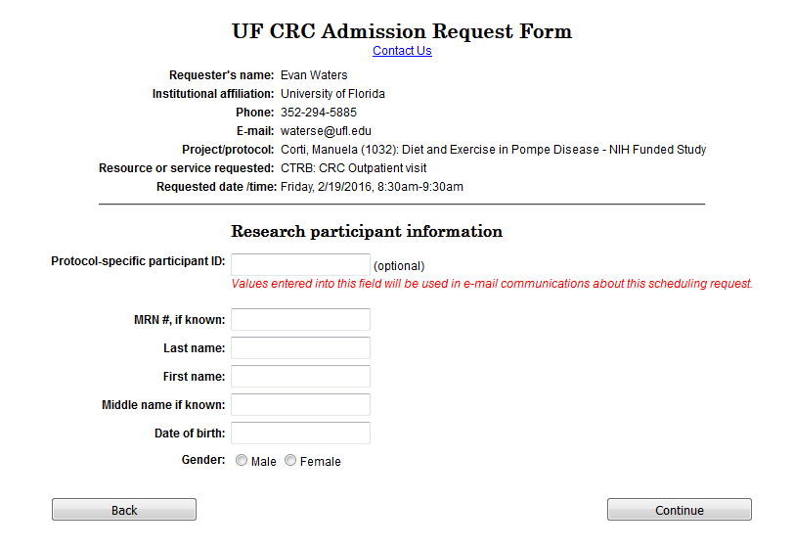
SCHEDULE REQUEST
On this screen, the research participant’s identifying information will be entered. The Protocol specific ID field is optional however, in order to maintain privacy it will be used to identify the subject in all e-mail correspondences so it’s inclusion is highly recommended.
Sub-01
The UF CTSI is supported in part by NIH Clinical and Translational Science Awards UL1TR001427, KL2TR001429 and TL1TR001428.
This content is solely the responsibility of the UF CTSI and does not necessarily represent the official views of the NIH.

Slide 34
SCHEDULE REQUEST
If the subject has an MRN#, please enter it here. Otherwise, a dummy MRN# will be created by the CRC for the subject.
Please note: If the protocol requires Shands’ services, including Investigational Drug Services (IDS) then an MRN is required.
Sub-01
1234567
The UF CTSI is supported in part by NIH Clinical and Translational Science Awards UL1TR001427, KL2TR001429 and TL1TR001428.
This content is solely the responsibility of the UF CTSI and does not necessarily represent the official views of the NIH.

Slide 35
SCHEDULE REQUEST
Enter the participant’s data into the text fields and click the radio button corresponding to the participant’s gender. Click the “Continue” button to accept the data and progress to the next screen.
Sub-01
1234567
Participant
Patty
P
01/01/1995
The UF CTSI is supported in part by NIH Clinical and Translational Science Awards UL1TR001427, KL2TR001429 and TL1TR001428.
This content is solely the responsibility of the UF CTSI and does not necessarily represent the official views of the NIH.

Slide 36
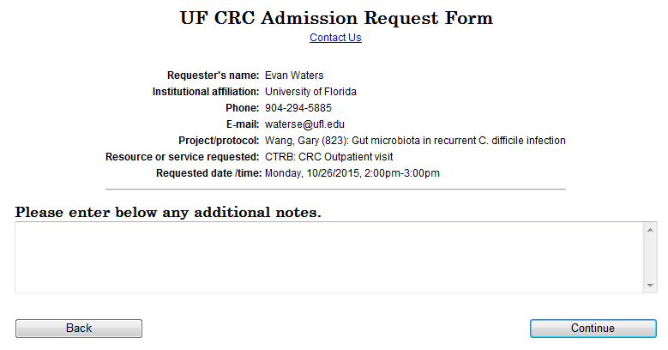
SCHEDULE REQUEST
Enter your notes here.
You may enter any pertinent notes about your subject or your request, such as a specific room request. This field is optional. Click “Continue” to accept the data and progress to the next screen.
The UF CTSI is supported in part by NIH Clinical and Translational Science Awards UL1TR001427, KL2TR001429 and TL1TR001428.
This content is solely the responsibility of the UF CTSI and does not necessarily represent the official views of the NIH.

Slide 37
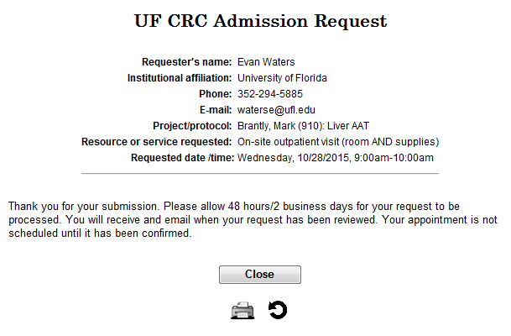
SCHEDULE REQUEST
The schedule request has been submitted to the CRC.
It will be reviewed and a response will be emailed to the requester. The schedule is not finalized until you receive the email.
The UF CTSI is supported in part by NIH Clinical and Translational Science Awards UL1TR001427, KL2TR001429 and TL1TR001428.
This content is solely the responsibility of the UF CTSI and does not necessarily represent the official views of the NIH.

Slide 38
SCHEDULE REQUEST
If you do not receive a response within 48 hours or 2 business days, please contact the CRC.
The UF CTSI is supported in part by NIH Clinical and Translational Science Awards UL1TR001427, KL2TR001429 and TL1TR001428.
This content is solely the responsibility of the UF CTSI and does not necessarily represent the official views of the NIH.

Slide 39
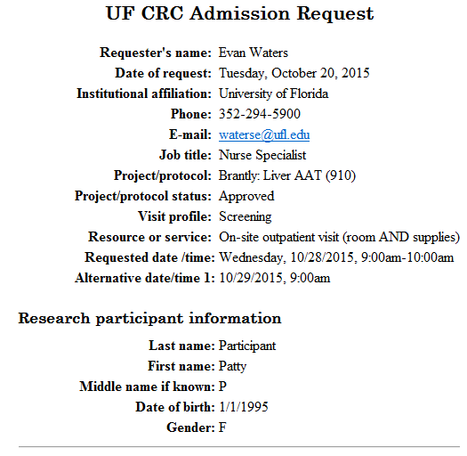
SCHEDULE REQUEST
Click the printer icon to display a printable PDF form with the scheduling information for your records.
The UF CTSI is supported in part by NIH Clinical and Translational Science Awards UL1TR001427, KL2TR001429 and TL1TR001428.
This content is solely the responsibility of the UF CTSI and does not necessarily represent the official views of the NIH.

Slide 40
SCHEDULE REQUEST
Click the repeat icon to return to the beginning of the form and create a new schedule request. Click close if you are finished entering schedule requests.
The UF CTSI is supported in part by NIH Clinical and Translational Science Awards UL1TR001427, KL2TR001429 and TL1TR001428.
This content is solely the responsibility of the UF CTSI and does not necessarily represent the official views of the NIH.

Slide 41
You’re finished! Thank you for viewing the Clinical Research Center’s presentation on WebCAMP participant scheduling.
The UF CTSI is supported in part by NIH Clinical and Translational Science Awards UL1TR001427, KL2TR001429 and TL1TR001428.
This content is solely the responsibility of the UF CTSI and does not necessarily represent the official views of the NIH.

