Slide 1
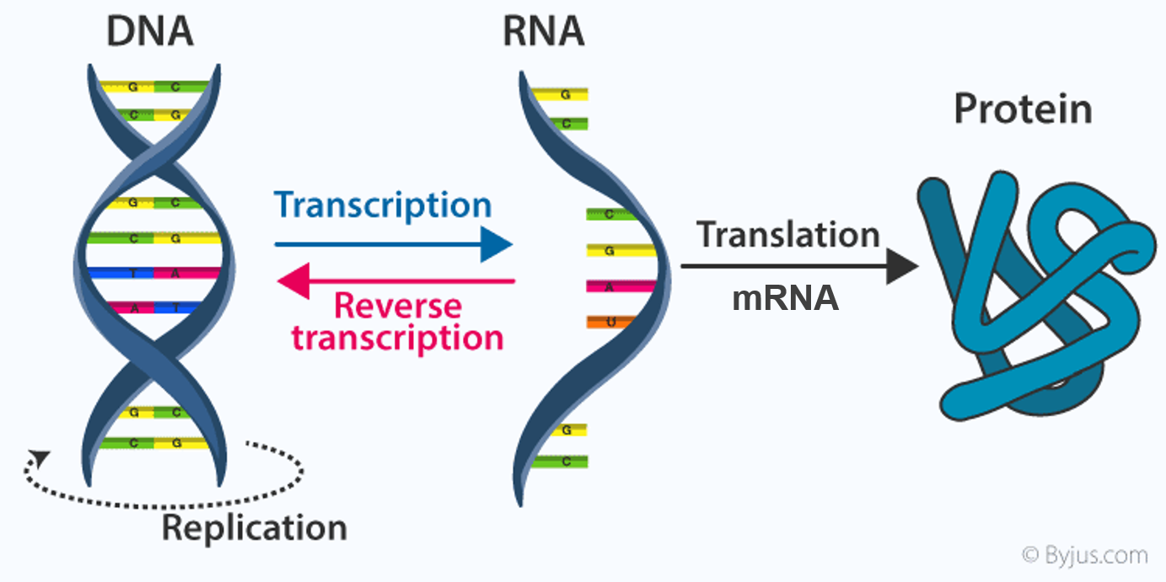
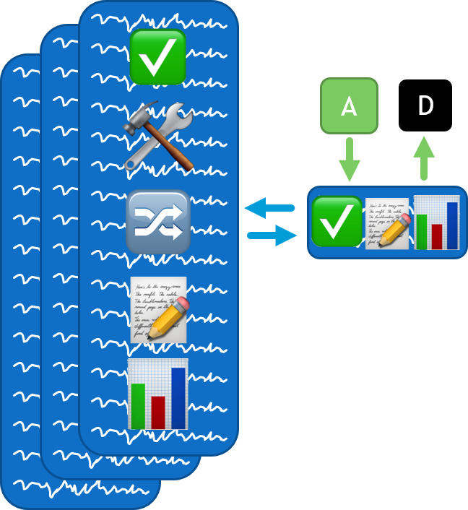
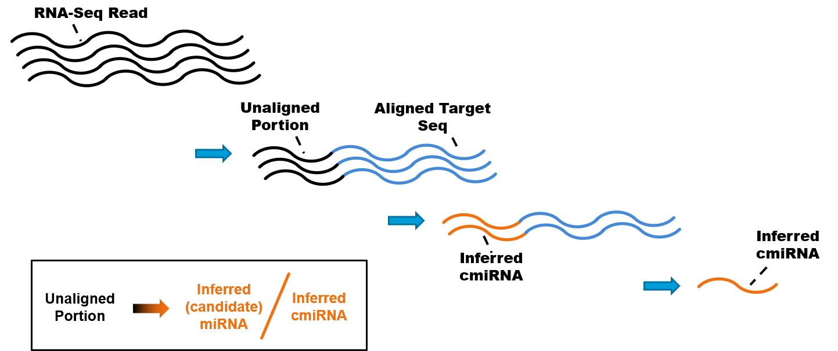
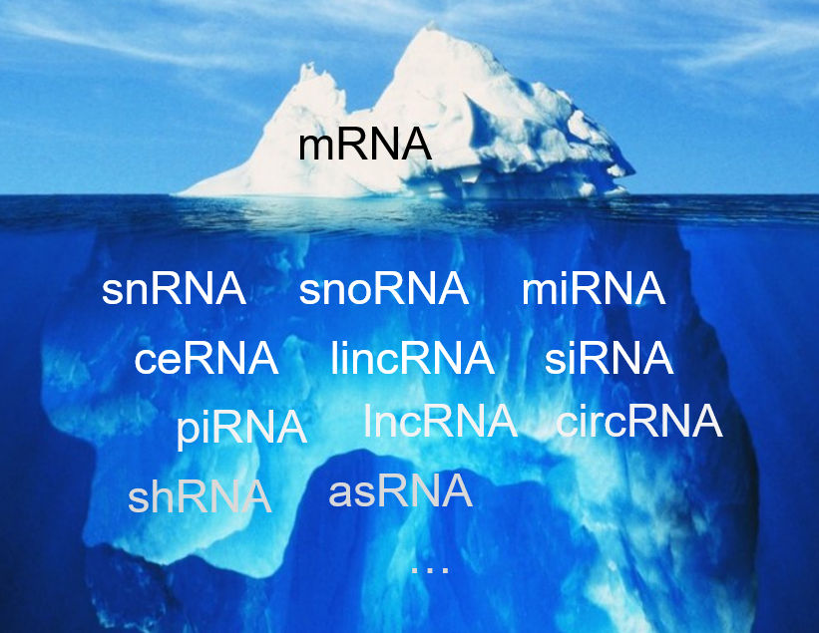
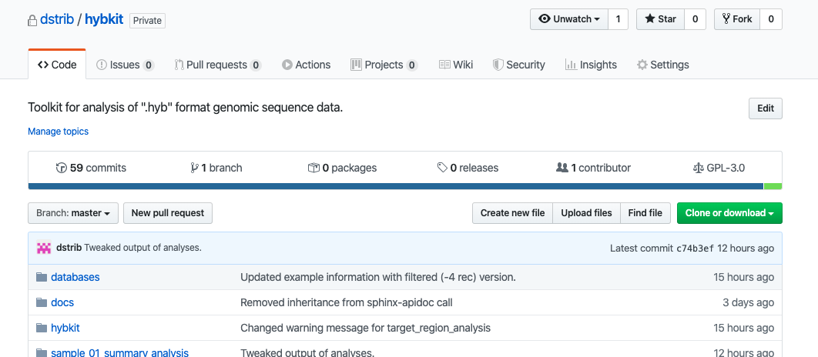
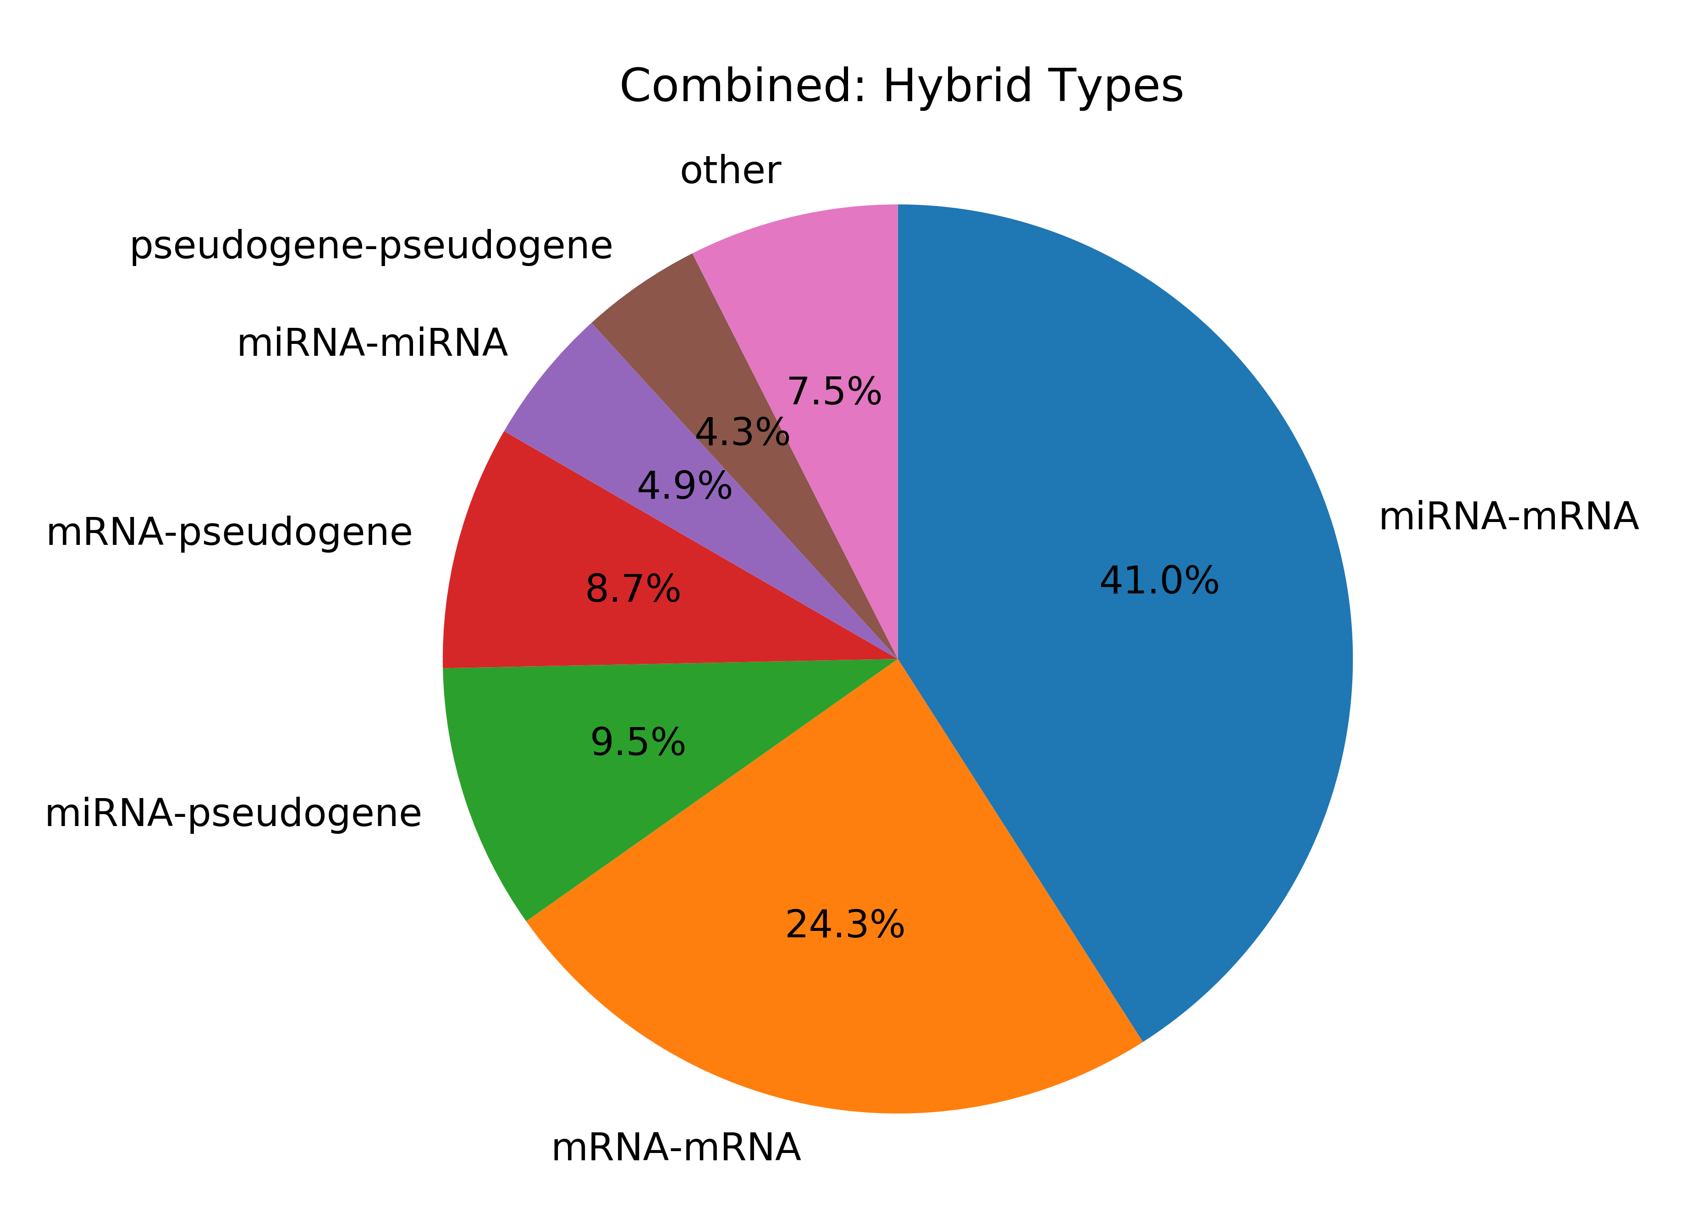
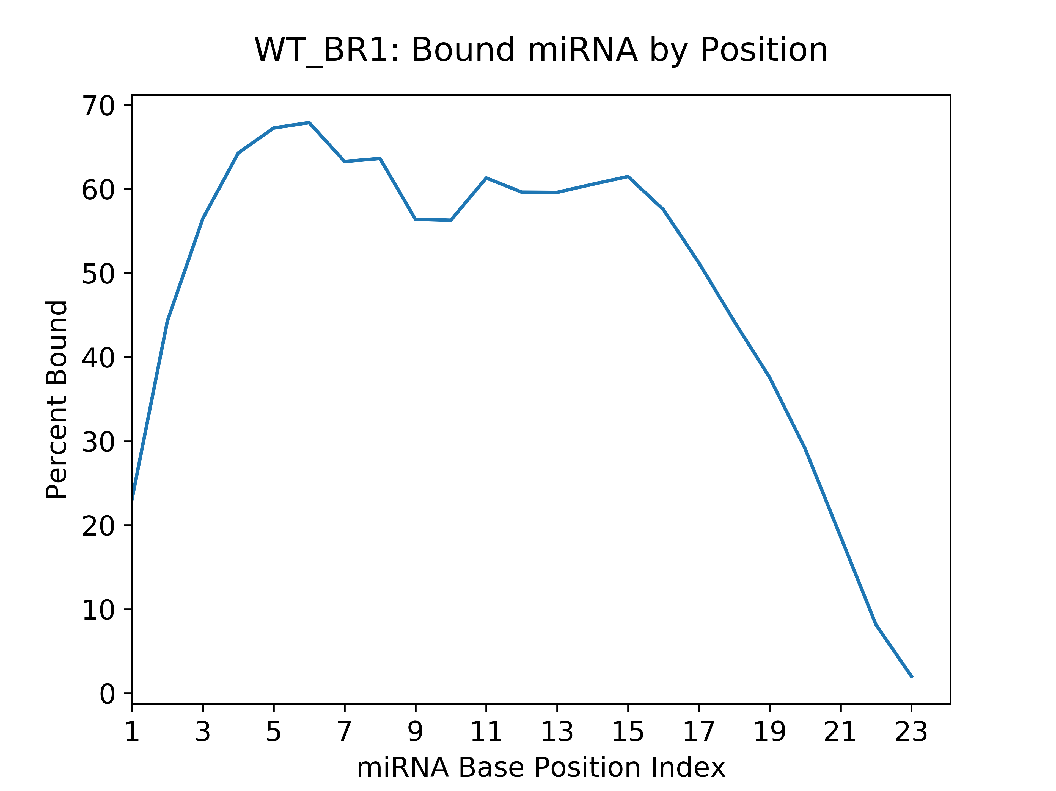
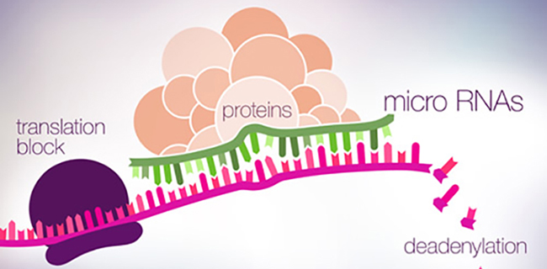
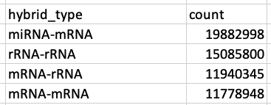
Interrogating the Cancer Noncoding Transcriptome via Novel Bioinformatics Methodology
qCLASH Technique
Toolkit for RNA-Seq Hybrid Analysis
hybkit
hybkit toolkit allows automated, in-depth analysis of hybrid reads from ribonomics experiments
Novel miRNA Identification
The human genome encodes a diverse array of noncoding RNA (ncRNA)
~22nt micro RNA (miRNA) bind and regulate other RNA
miRNA mediate transcription blockage and target degradation
Novel miRNA Discovery technique uncovers Transcription Start Site miRNA in Drosha Knockdown Lines
Stribling D, Gay LA, and Rolf R.
1.https://byjus.com/biology/central-dogma-inheritance-mechanism/
2.https://www.genengnews.com/topics/omics/microrna-expression-could-be-key-to-leukemia-treatment/
3.Adapted: Gay, L., et al. Journal of Virology (2018)

