Slide 1
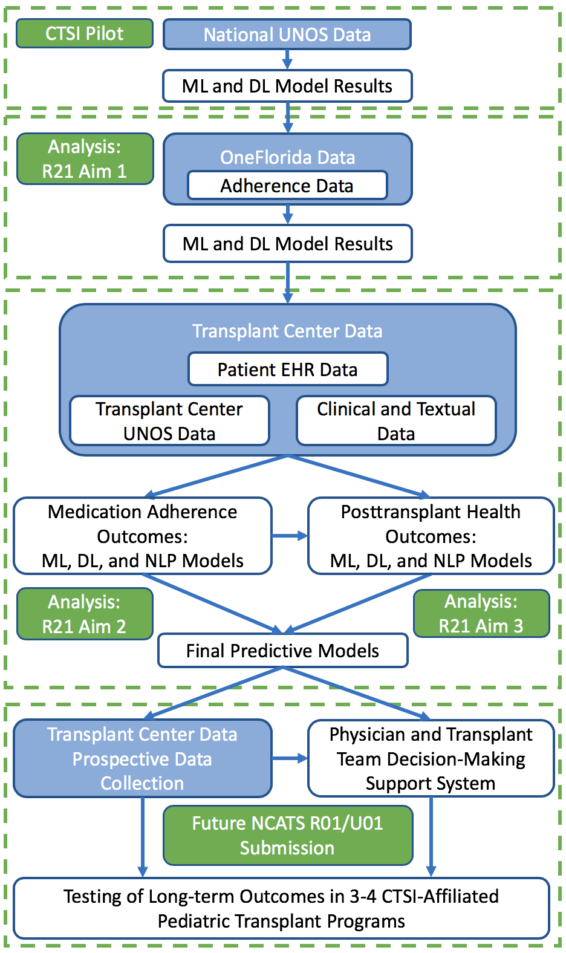
Machine Learning-Based Prediction of Health Outcomes in Pediatric Organ Transplantation Recipients: A Study Of Single Transplant Center
Mike Killian, PhD, MSW, and Zhe He, PhD, Florida State University; Dipankar Gupta, MBBS, DCH, MD, UF Health Congenital Heart Center
Introduction
Results: Heart Transplant & Hospitalizations
Next Steps
Prediction of posttransplant outcomes and survival has not been adequately addressed in pediatric populations.
Nationally, prediction modeling has relied on general linear modeling or Cox proportional hazards regression approaches, which offer limited predictive efficiency.
Further research is needed to improve medication adherence and posttransplant health outcomes through the use of abundant electronic health records (EHRs) with longitudinal clinical data as well as biomedical ontologies with rich domain knowledge in machine learning (ML) and predictive modeling.
AIM: The purpose of the current study was to test and examine ML models predicting the hospitalization due to adverse posttransplant events (organ rejection and infection) in samples of pediatric kidney, liver, and heart transplant recipients from a large solid organ transplant program.
Results from the current analysis will inform our approach with national transplant data. Here, data from a single pediatric transplant center was used to pilot data management and ML analytic approaches with pediatric transplant data.
Window | Algorithm | Precision | Recall | F-Measure | MCC | ROC | PRC | STDEV (ROC)
1-year | Logistic | 0.658 | 0.662 | 0.658 | 0.297 | 0.653 | 0.623 | 0.19
1-year | Naïve Bay | 0.76 | 0.746 | 0.748 | 0.501 | 0.847 | 0.858 | 0.15
1-year | MLP | 0.647 | 0.634 | 0.636 | 0.273 | 0.676 | 0.701 | 0.24
1-year | SGD | 0.602 | 0.606 | 0.604 | 0.185 | 0.591 | 0.565 | 0.2
1-year | SimpleLogistic | 0.65 | 0.648 | 0.649 | 0.282 | 0.704 | 0.725 | 0.1
1-year | SMO.NormalizedPolyKernel | 0.66 | 0.662 | 0.647 | 0.288 | 0.631 | 0.596 | 0.16
1-year | SMO.PolyKernel | 0.612 | 0.62 | 0.61 | 0.2 | 0.595 | 0.568 | 0.13
1-year | SMO.Puk |  | 0.577 |  |  | 0.5 | 0.512 | 0
1-year | SMO.RBF |  | 0.577 |  |  | 0.5 | 0.512 | 0
1-year | J48 | 0.591 | 0.577 | 0.58 | 0.159 | 0.578 | 0.567 | 0.2
1-year | LMT | 0.65 | 0.648 | 0.649 | 0.282 | 0.704 | 0.725 | 0.11
1-year | RandomForest | 0.637 | 0.634 | 0.635 | 0.257 | 0.688 | 0.7 | 0.17
1-year | LogitBoost | 0.586 | 0.577 | 0.58 | 0.15 | 0.57 | 0.587 | 0.19
1-year | DeepLearning | 0.907 | 0.903 | 0.901 |  | 0.878 | 0.849 | 0.15
Window | Algorithm | Precision | Recall | F-Measure | MCC | ROC | PRC | STDEV (ROC)
3-year | Logistic | 0.632 | 0.633 | 0.632 | 0.254 | 0.661 | 0.659 | 0.1
3-year | Naïve Bay | 0.717 | 0.712 | 0.713 | 0.426 | 0.75 | 0.743 | 0.12
3-year | MLP | 0.67 | 0.672 | 0.67 | 0.332 | 0.695 | 0.682 | 0.1
3-year | SGD | 0.688 | 0.689 | 0.687 | 0.367 | 0.681 | 0.629 | 0.12
3-year | SimpleLogistic | 0.758 | 0.734 | 0.72 | 0.475 | 0.723 | 0.717 | 0.08
3-year | SMO.NormalizedPolyKernel | 0.749 | 0.729 | 0.715 | 0.461 | 0.707 | 0.661 | 0.07
3-year | SMO.PolyKernel | 0.699 | 0.701 | 0.698 | 0.389 | 0.692 | 0.638 | 0.13
3-year | SMO.Puk | 0.695 | 0.661 | 0.627 | 0.325 | 0.63 | 0.596 | 0.08
3-year | SMO.RBF | 0.762 | 0.582 | 0.455 | 0.19 | 0.532 | 0.53 | 0.07
3-year | J48 | 0.678 | 0.678 | 0.678 | 0.348 | 0.687 | 0.648 | 0.13
3-year | LMT | 0.736 | 0.718 | 0.703 | 0.435 | 0.722 | 0.714 | 0.09
3-year | RandomForest | 0.733 | 0.729 | 0.723 | 0.449 | 0.746 | 0.74 | 0.07
3-year | LogitBoost | 0.7 | 0.701 | 0.697 | 0.389 | 0.752 | 0.737 | 0.09
3-year | DeepLearning | 0.923 | 0.883 | 0.87 |  | 0.877 | 0.858 | 0.13
Window | Algorithm | Precision | Recall | F-Measure | MCC | ROC | PRC | STDEV (ROC)
5-year | Logistic | 0.725 | 0.718 | 0.72 | 0.418 | 0.73 | 0.731 | 0.19
5-year | Naïve Bay | 0.75 | 0.735 | 0.738 | 0.467 | 0.782 | 0.777 | 0.1
5-year | MLP | 0.669 | 0.669 | 0.669 | 0.301 | 0.683 | 0.686 | 0.12
5-year | SGD | 0.702 | 0.707 | 0.703 | 0.37 | 0.679 | 0.643 | 0.09
5-year | SimpleLogistic | 0.774 | 0.768 | 0.755 | 0.501 | 0.81 | 0.804 | 0.09
5-year | SMO.NormalizedPolyKernel | 0.756 | 0.74 | 0.717 | 0.441 | 0.683 | 0.659 | 0.06
5-year | SMO.PolyKernel | 0.746 | 0.74 | 0.723 | 0.436 | 0.691 | 0.661 | 0.09
5-year | SMO.Puk | 0.774 | 0.641 | 0.526 | 0.212 | 0.536 | 0.553 | 0.09
5-year | SMO.RBF | 0.767 | 0.624 | 0.491 | 0.133 | 0.514 | 0.537 | 0.08
5-year | J48 | 0.715 | 0.718 | 0.716 | 0.399 | 0.699 | 0.682 | 0.11
5-year | LMT | 0.774 | 0.768 | 0.755 | 0.501 | 0.81 | 0.804 | 0.09
5-year | RandomForest | 0.777 | 0.773 | 0.763 | 0.512 | 0.811 | 0.823 | 0.1
5-year | LogitBoost | 0.737 | 0.74 | 0.732 | 0.436 | 0.753 | 0.753 | 0.11
5-year | DeepLearning | 0.915 | 0.902 | 0.9 |  | 0.898 | 0.866 | 0.09
Methods, Data, and Modeling
Patients
The sample were pediatric kidney, heart, or liver recipients (ages 0 through 18) from a large southwestern pediatric transplant center between 2009 and May 31, 2017. Patients surviving less than one-year posttransplant were excluded from the data prior to analyses.
UNOS Data
Using center data reported to the United Network for Organ Sharing (UNOS, U.S. Department of Health and Human Services), individual, family, and medical variables was used to predict long-term health and transplant outcomes.
UNOS data maintains national and center level data on organ transplant patients beginning when listed as a candidate for transplantation. Each transplant center is required to maintain data on all transplant patients. Pretransplant and posttransplant medical and health data are available for each patient.
ML and DL Modeling
We used conventional ML techniques (e.g., random forest, logistic regression, support vector machine) and DL models to develop and evaluate prediction models for hospitalization within the 1-, 3-, and 5-year posttransplant periods for each organ type.
An Exploratory Collaborative Innovation Awards (R21 Clinical Trial Optional, PAR-19-100) application
resubmitted in July 2020 to NCATS.
The R21 project aims to collect patient EHR data from data or even data from UF Shands Children’s Hospital and the Miami Transplant Institute Pediatric Center including information from unstructured features of EHRs (clinical notes).
Multidisciplinary teams in pediatric transplant centers will benefit from decision support tools to identify patients at greatest risk for poor posttransplant outcomes.
Discussion
Across organ types and posttransplant periods, Deep Learning approaches provided the optimal models for prediction.
Numerous pretransplant and early period pretransplant variables predicted posttransplant hospitalization.
Variables included patient variables (education, gender, age), medical features (creatine levels, ICU prior to transplant), and social (ethnicity, proxy-measures for SES).
Research funded by NIH/NCATS Clinical and Translational Science Awards to the University of Florida 2UL1TR001427-05

