Slide 1
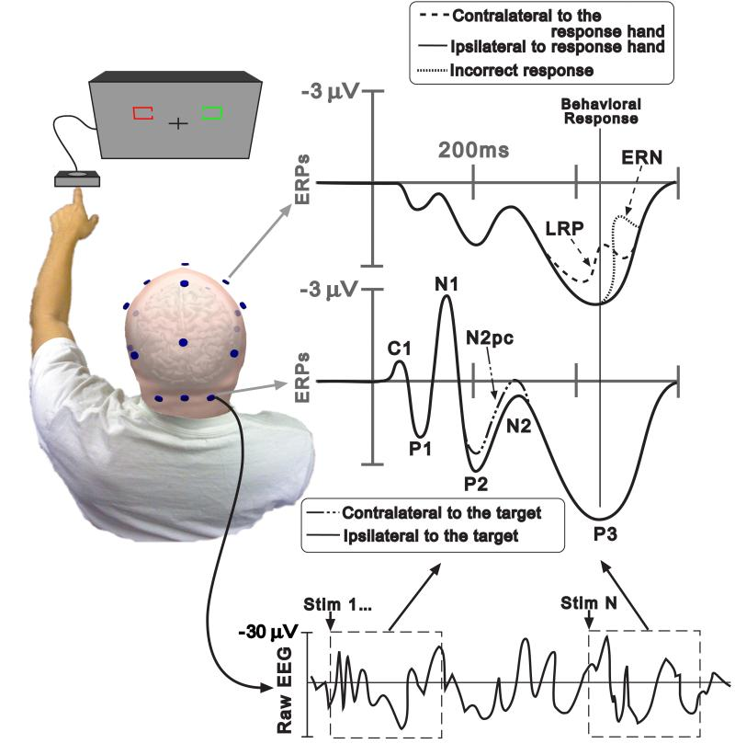
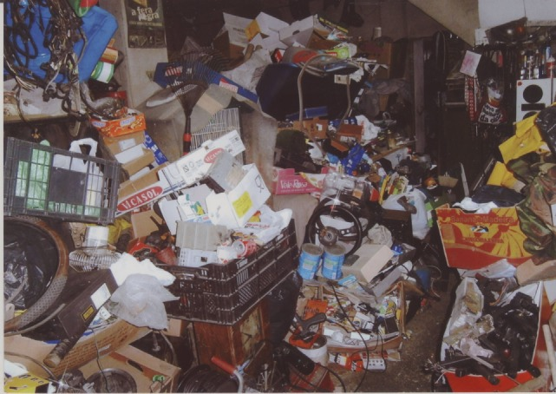
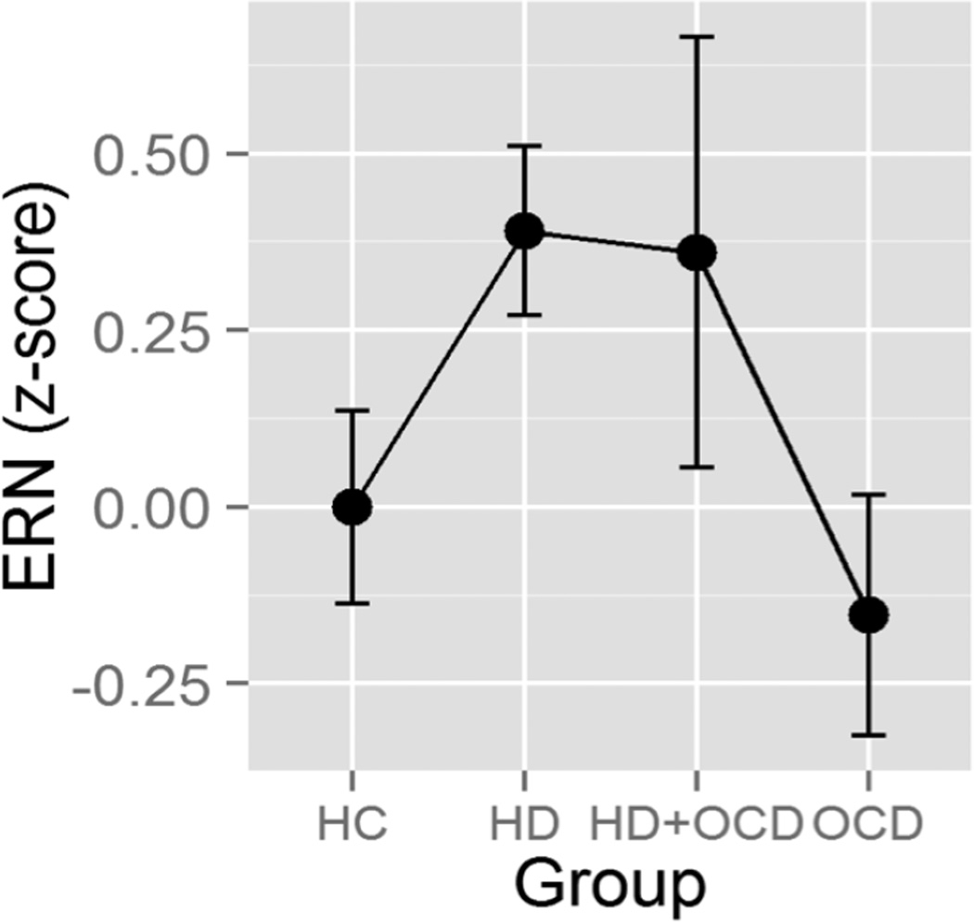
Aim 1: Use EEG (electroencephalography) to examine the visual mismatch negativity waveform in hoarding disorder and its relationship to hoarding symptom severity Aim 2: Determine what structural brain changes might occur in hoarding disorder in particular regions of interest using MRI, and relate these neuroimaging findings to hoarding symptom severity
Visual Mismatch Negativity and Structural Connectivity in Hoarding Disorder
VISUAL MISMATCH NEGATIVITY (vMMN)
Represents a violation of a regularity or pattern and the brain’s ability to perform automatic comparisons (i.e. environmental change detection and discrimination/perceptual accuracy). vMMN is sensitive to infrequent/surprising stimuli
Patients with hoarding disorder demonstrate deficits on visual discrimination, visual categorization, and visual memory on neuropsych testing and thus might demonstrate an attenuated vMMN response
Binh Nguyen, B.S., Carol Mathews, M.D.
INTRODUCTION
Hoarding disorder (HD) is a psychiatric condition characterized by difficulty and distress with discarding possessions of minimal value as well as the accumulation of clutter that impairs quality of life and the functional use of living spaces
Hoarding disorder was only recently defined in the DSM-5 as a distinct entity
There are inconsistencies in the prior literature and we lack a full understanding of the neurobiological underpinnings of HD
Our paradigm involves stimuli that vary on dimensions such as color, duration, shape, size, and orientation, each of which elicits a vMMN response because the presented stimulus is a mismatch with the previous one
EEG reflects how the brain processes information temporally
3T Siemens Prisma scanner
METHODS
EEG
Neuroimaging (T1, DTI, MRS, resting state fMRI)
WHY USE THESE TECHNIQUES?
They provide noninvasive, objective measurements
Can offer insight into the underlying cognitive abnormalities in HD
Will allow us to build a neurobiological profile for HD and compare across disorders
Findings could potentially serve as biomarkers
Previous literature in HD is sparse
TRACULA reconstructs white matter pathways from DTI
FreeSurfer pipeline for structural T1
Other EEG waveforms such as error-related negativity (error processing/monitoring) have been shown to differ in HD
FUTURE DIRECTIONS
Perform task-based MRI
Expand from ROI to whole-brain analyses
Replicate findings with larger samples
Investigate other EEG waveforms
Monitor whether these markers respond to treatment and track progression over time
Magnetic resonance spectroscopy output from Gannet measures levels of brain metabolites such as GABA
CONN, a toolbox for functional connectivity between brain regions

