Slide 1
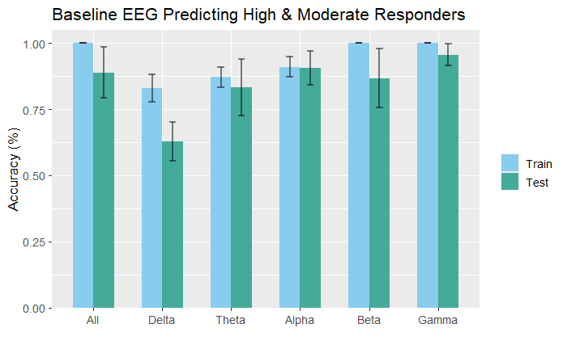
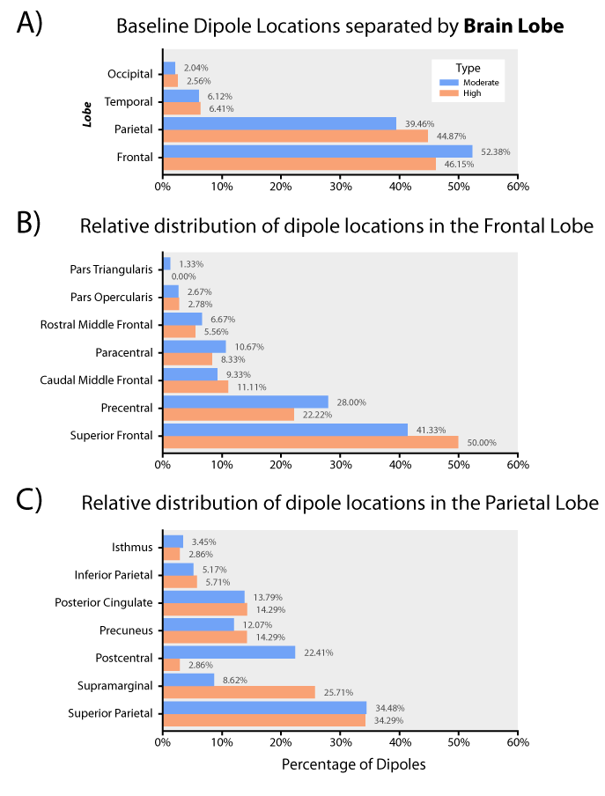
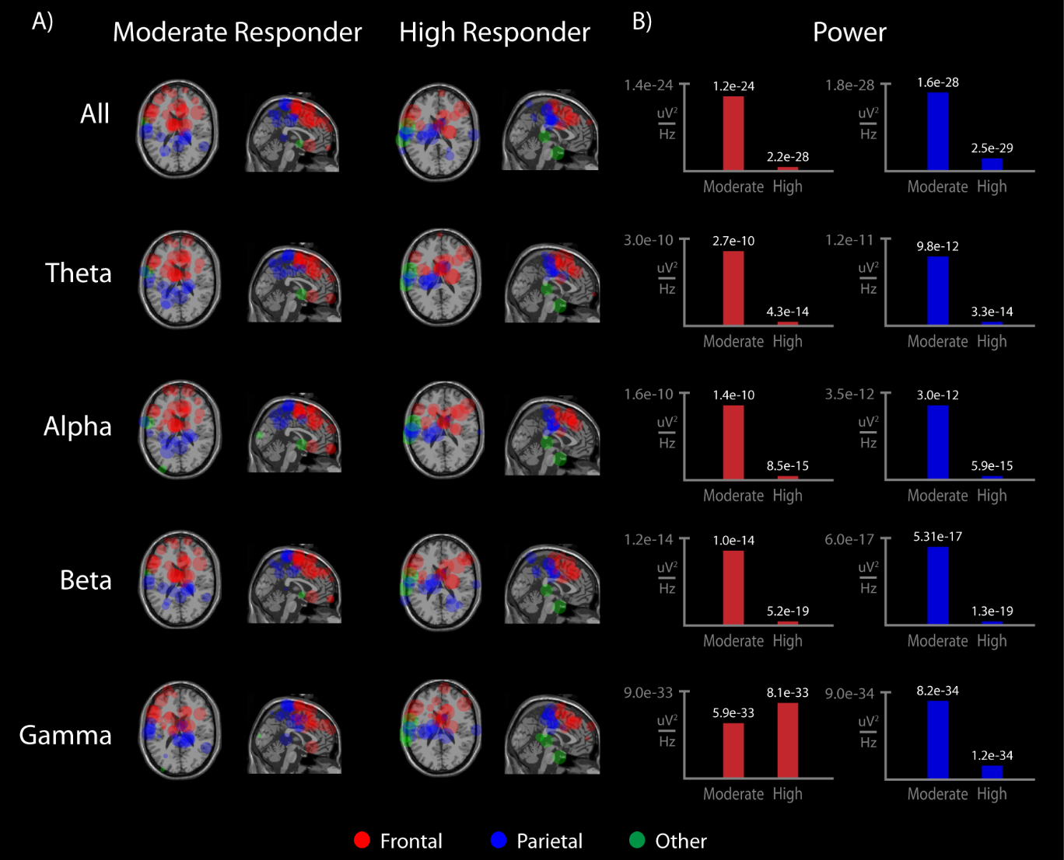
TL1 Team Approach to Predicting Response to Spinal Cord Stimulation for Chronic Low Back Pain
Kyle B See, Rachel L.M. Ho, Ruogu Fang, Stephen A. Coombes
Introduction
There is no non-invasive method for predicting relief provided by spinal cord stimulation (SCS) in individuals with chronic low back pain (CLBP)
We hypothesize that neural activity from the brain can fill this gap
Methods
We collected resting electroencephalography (rEEG) from 7 patients before trial surgery (baseline) and 6 months after permanent SCS implant (long-term)
Patients were designated as high and moderate responders based on amount of pain relief provided by long-term SCS
Data processing overview
a – b) rEEG was preprocessed before submitted through spectral analysis. c) frequency bands from 1 – 100 were selected as feature inputs. d – f) SVM model used frequency band as inputs to classify moderate and high responders, key frequencies were identified, and decomposed into subcomponents. g) subcomponents were plotted
Results
Figure 2 shows the entire spectrum of 1 – 100 Hz across all electrodes yielded a classification accuracy of 88.89%.
Figure 3 provides a breakdown of dipole locations for moderate and high responders at baseline.
Figure 1 shows the anatomical location of all dipole sources. The size and opacity are scaled from the machine learning weights. The mean power within each power band for the top 3 ranked dipoles is shown on the left hand side
Conclusions
We provide evidence that decreased power in theta, alpha, and beta in the anterior regions of the parietal cortex and posterior regions of the frontal cortex can be harnessed for predicting long-term pain relief from burst SCS.
Resting electroencephalography at baseline predicted pain relief with 88.89% accuracy
Fig 2
Fig 3
Fig 1
This work supported in part by the NIH/NCATS Clinical and Translational Science Awards to the University of Florida UL1TR001427 and TL1TR001428

