Slide 1
Genomic Centers for Infectious Disease (GCID) Program
RFA-AI-23-015
U19 Cooperative Agreement

Slide 2
Purpose
To advance the development and use of innovative genomic and bioinformatics tools: emphasis on human pathogens and their interactions with the host and microbiome
To rapidly respond to emerging needs, especially during disease outbreaks
To address basic, translational, and clinically relevant questions in host-pathogen interactions.
To support the development of genomics-based tools to diagnose, prevent, and treat infectious diseases.
To be poised to leverage the expertise and resources within the network to assist in a coordinated research response.

Slide 3
HOUSEKEEPING
IMPORTANT DATES
May 2, 2023 – nonbinding letter of intent due
June 2, 2023 – application due date
FUNDING
Application budgets are not expected to exceed $2.85 million in direct costs per year, which includes up to $50,000 in direct costs for one Collaborative Pilot Project per year. NO SPECIFIC COMPONENT BUDGET LIMITS
The maximum period is 5 years.
More than one application per institution allowed
NO CLINICAL TRIALS
Foreign components are allowed

Slide 4
GCID Program Components
Overall
Administrative Core (1) 12 pages
Technology and Data Core (1) 12 pages
Optional Scientific Core (1) 6 pages
Research Projects (4) 12 pages each

Slide 5
Administrative Core
Headed by the Contact PD/PI, that will be responsible for Center activities
Collaborative Pilot Projects (CPPs): This FOA supports Collaborative Pilot Projects for small-scale studies in areas of shared scientific or technological interest between the funded GCIDs, and of benefit to the broader scientific community. The projects will be identified by the Administrative Core with input from the Administrative Core Leader and with NIAID consultation.
Emergency Response Projects (ERPs): This FOA supports Emergency Response Projects to develop critical genomics-based technological tools, methods, and studies that advance our understanding of pathogens during pandemic and epidemic outbreaks. Similar to the CPPs, the projects will be identified by the Administrative Core and its leaders, with NIAID consultation.
Plan for Enhancing Diverse Perspectives (PEDP): This initiative requires a Plan for Enhancing Diverse Perspectives. The Administrative Core will oversee and ensure the implementation of the Center's PEDP.

Slide 6
Technology and Data Core
Support research and development to offer innovative genomic and data technologies as a shared resource to all research projects.
The Core synergizes with the Research Projects
1) develop innovative genome and related sequencing technologies and approaches, including large-scale high-throughput sequencing, transcriptomics, and metagenomics;
2) provide data analysis and management capabilities and support, including innovative bioinformatics, computational and data visualization, and integration approaches; and
3) efficiently and rapidly disseminate generated data, analysis tools, reagents, and other resources generated to the broader scientific

Slide 7
Optional Scientific Core
To support resources and/or facilities that are essential for the activities of two or more Research Projects.
Optional Cores must be well justified and provide support to at least 2 Research Projects

Slide 8
Research Projects
Must propose 4 separate Research Projects
Each addresses a different human pathogen group centered around the theme of viruses, bacteria, fungi, parasites, and vectors.
Applicants are encouraged to incorporate pathogens in the NIAID priority pathogens list and Prototype Pathogens, as well as microbiome analysis
Research projects are:
expected to incorporate state-of-the-art technologies and approaches and use a combination of genomic sequencing, functional genomics, and bioinformatics analyses to understand infectious diseases
expected that during pathogen outbreaks, the relevant research project is prepared to undertake Emergency Response Projects to support NIAID's infectious disease response and to advance knowledge about emerging pathogens

Slide 9
UF GCID
Key Investigators
Co-PDs (Administrative Core)
Marco Salemi, George Drusano, Mattia Prosperi
Co-PI/co-Inv
Brittany Rife Magalis
Bian Jiang
Megan Stanifer
Steeve Boulant
Steven Madore (ICBR)
Simone Marini
Rui Yin
Derek Cummings
Glenn Morris
Carla Mavian
Drusano’s group…
Susana Valente (Scripps)
Matthew Disney (Scripps)
David Bloom (epigenetic regulation)
Jason Blackburn
Proposed Vision (so far):
A comprehensive Genomic Data Science/AI framework for diagnosing, preventing, and treating microbial infections
(1) Single-cell One-Shot Multi-Omic SequencIng System (sc-OSMOSIS)
Development of one-platform/one experiment system for sc host/pathogen genomic, transcriptomic and cell phenotyping
(2) Organoids technology for drug discovery
(3) Data science
Technology and
Data Core
Data Intelligence Scientific Core
AI modelling services: data analyses, learning, forecast

Slide 10
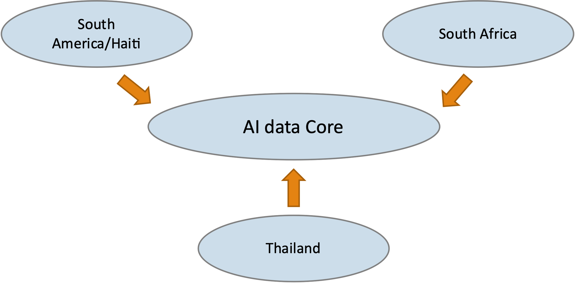
UF GCID
A comprehensive Genomic Data Science/AI framework for diagnosing, preventing, and treating microbial infections
Fungi
Viruses
Bacteria
Parasites
Threat assessment/Forecast
Proposed Vision (so far)
Fast response
Host/pathogen scDNA sequencing
Host/pathogen scRNA sequencing
3D tissues bioprinting/organoids
Diagnostic biomarkers/drug discovery
Phylodynamic/Phyloanatomy modeling

